Slide 2
FOMO on the coolest new MLOps tool? Here’s a solution that lets you switch anytime!
Jayesh Sharma — wjayesh@outlook.com

Slide 3
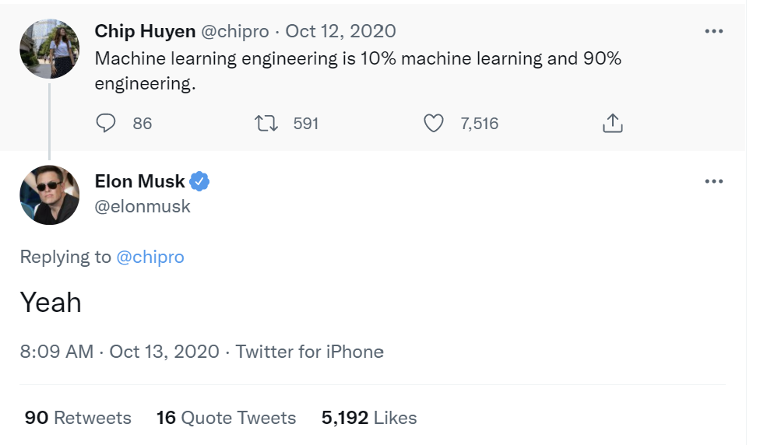
ML in the industry is more than training models

Slide 4
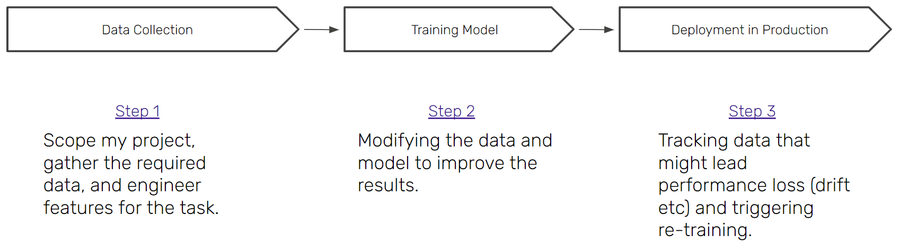
ML in Production: What we think it looks like

Slide 5
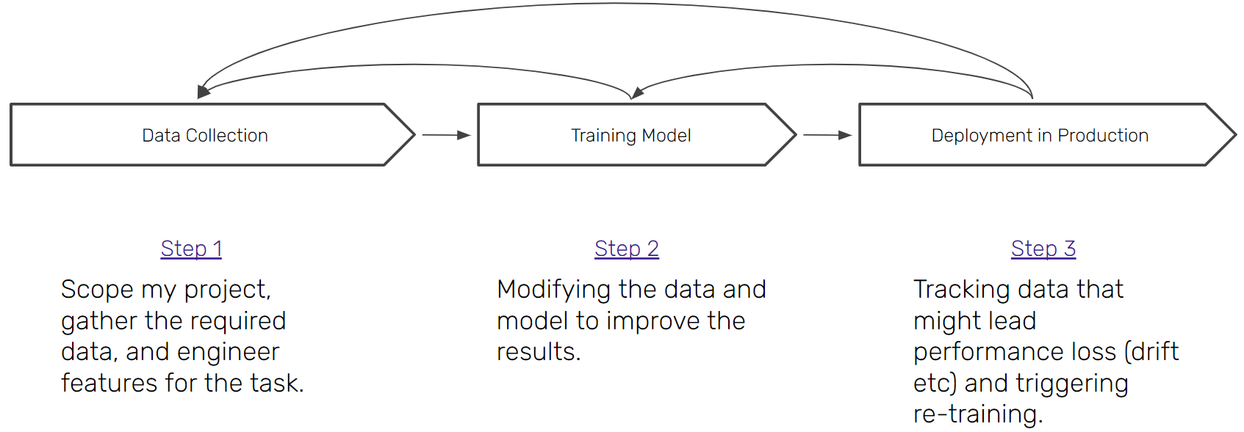
ML in Production: What we think it looks like

Slide 6


About me
I build and manage the infrastructure for machine learning applications at ZenML.
Enjoy coding, sports and music.
Love open source ❤ and hiking in the nature!
Twitter: @wjayesh
Jayesh Sharma
Jr. Platform Engineer, ZenML
jayesh.ext@zenml.io

Slide 7
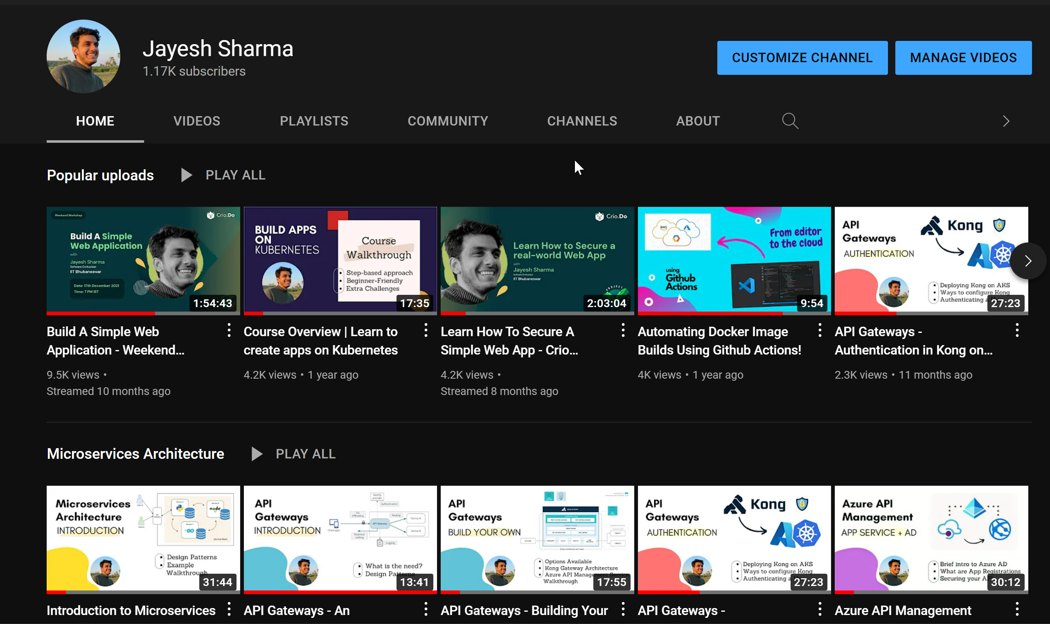
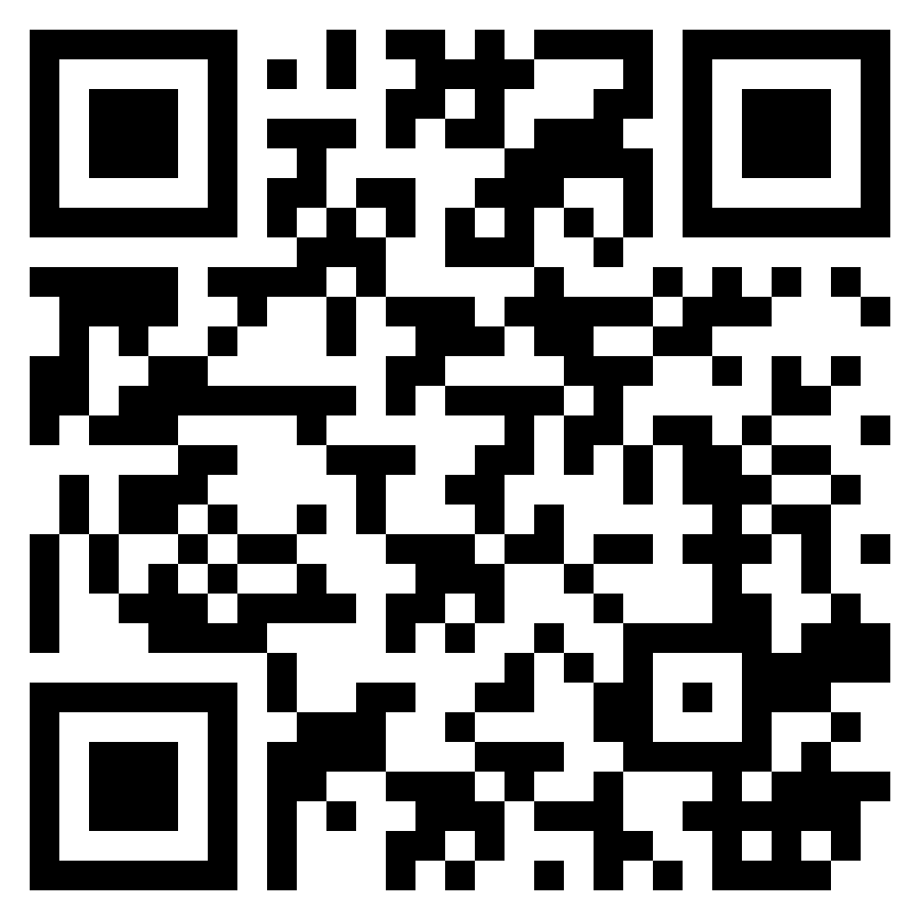
YouTube

Slide 8



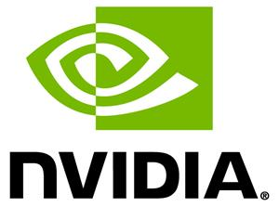








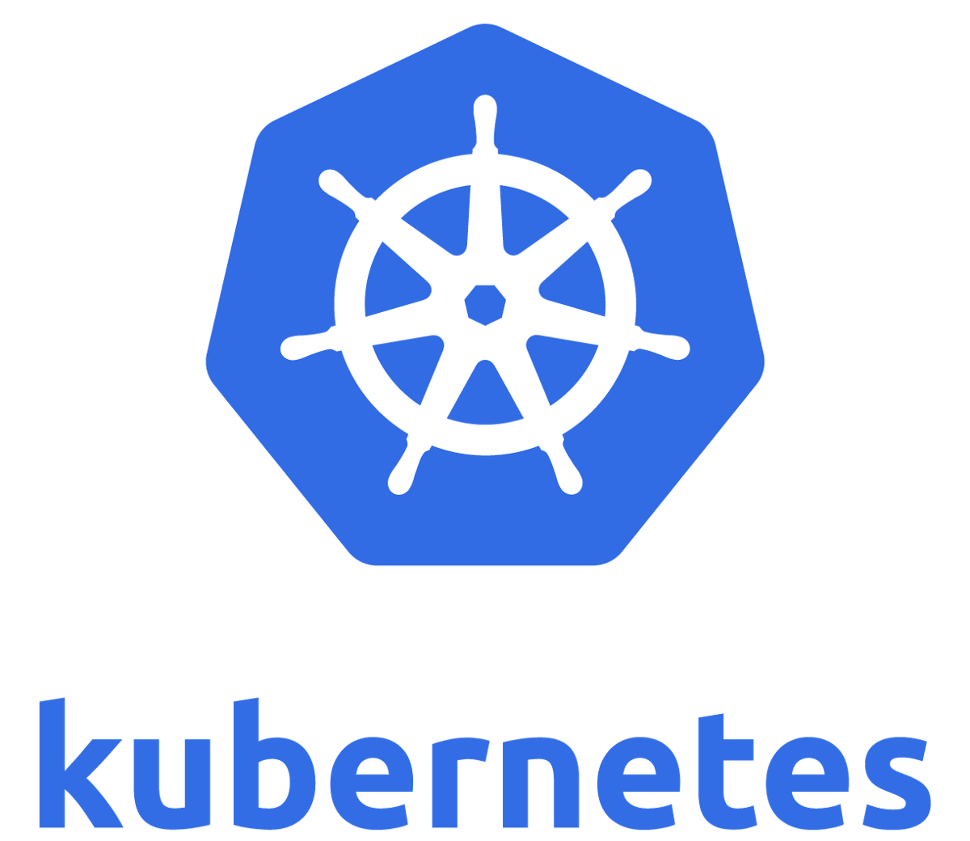







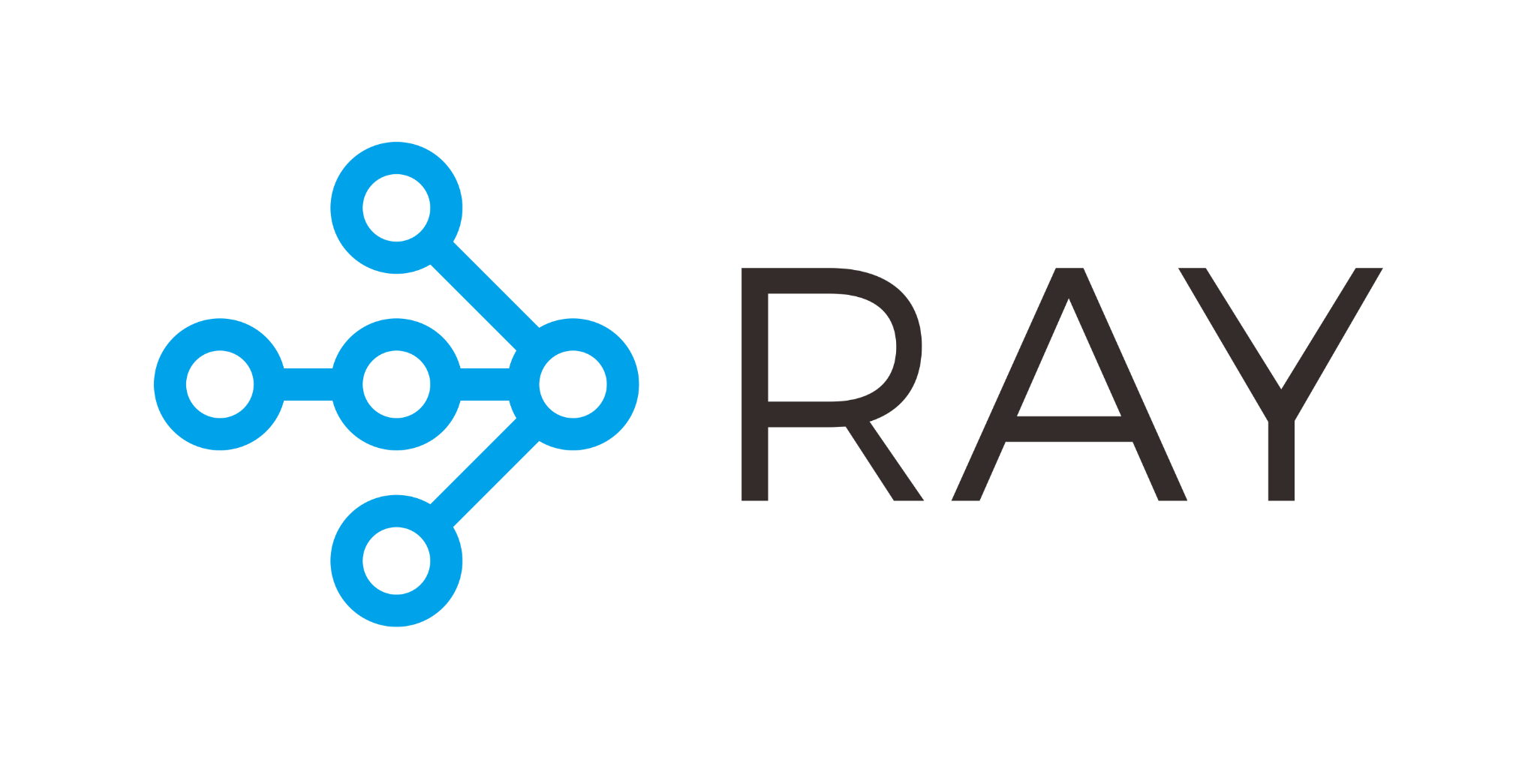






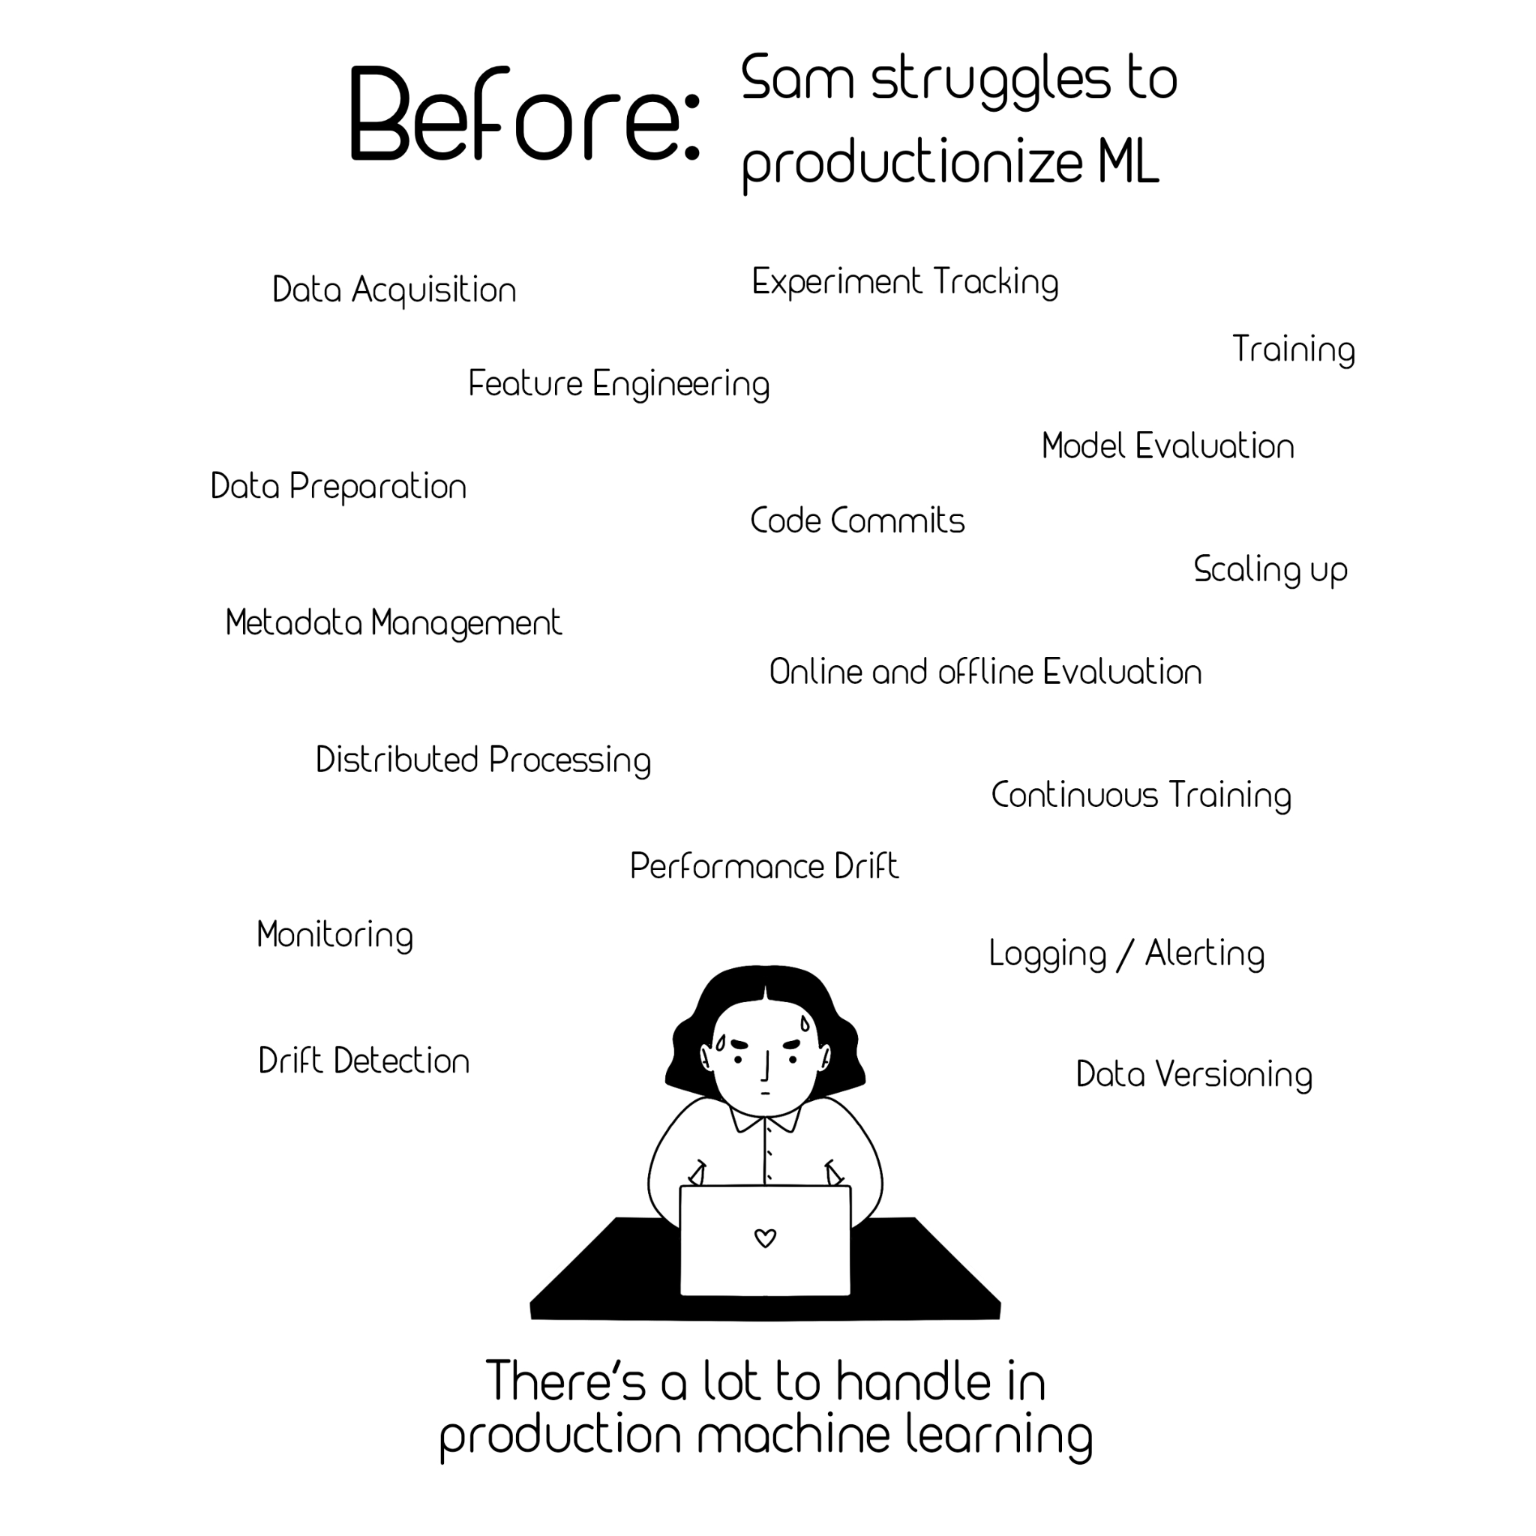
Problem: Complex MLOps Landscape
Source: Full Stack Deep Learning Course

Slide 9
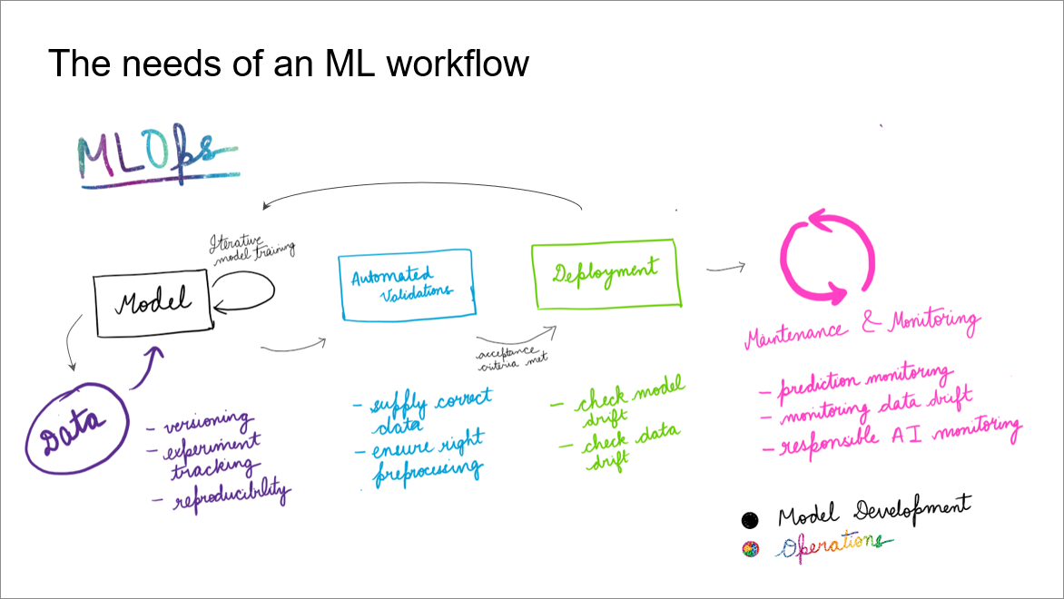
Notes:
It's easier to think of them in terms of different stack components.
But first, Let's see what an mlops lifecycle looks like.

Slide 10

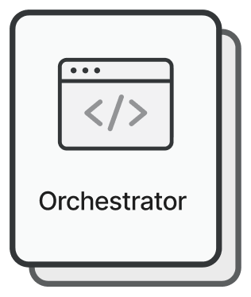
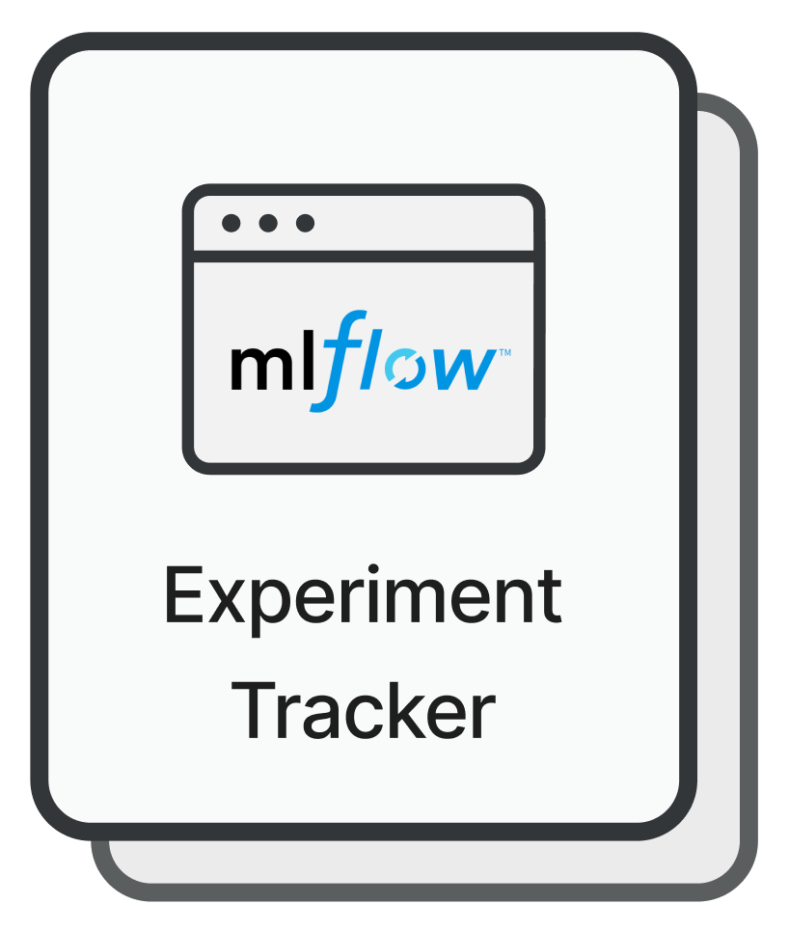




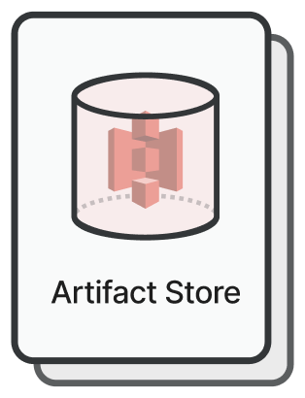
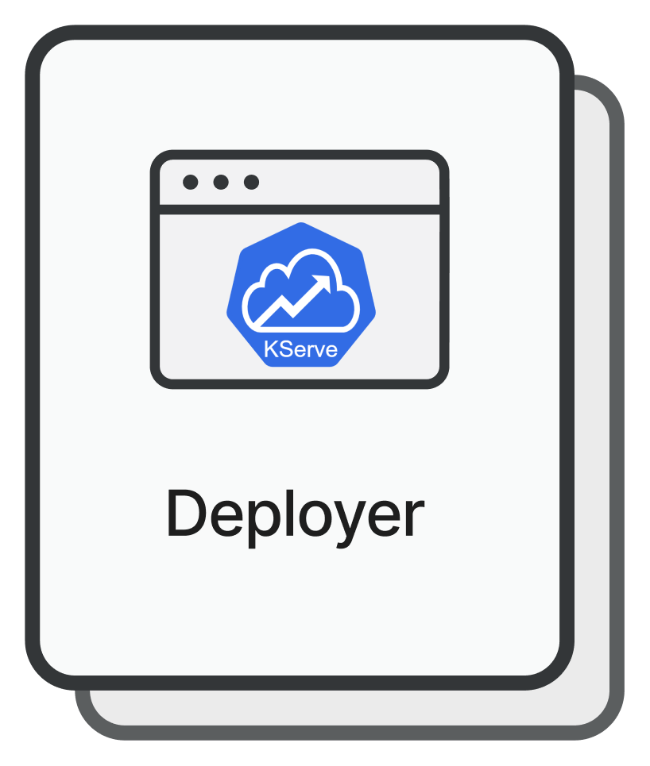


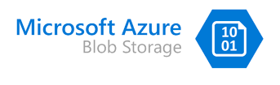

Notes:
Now each of the concerns in the previous slide are addressed by one or the other stack component. These are the most commonly used stack components.
For each of these components, you have multiple tools. So all of the tools we saw earlier can fit into one or more of these separations.

Slide 11
Choosing the right MLOps tool 😎
Each tool offers some or the other advantage and is best suited for specific use-cases.
You might want to do a “field test” to determine what works best for you.

Slide 12
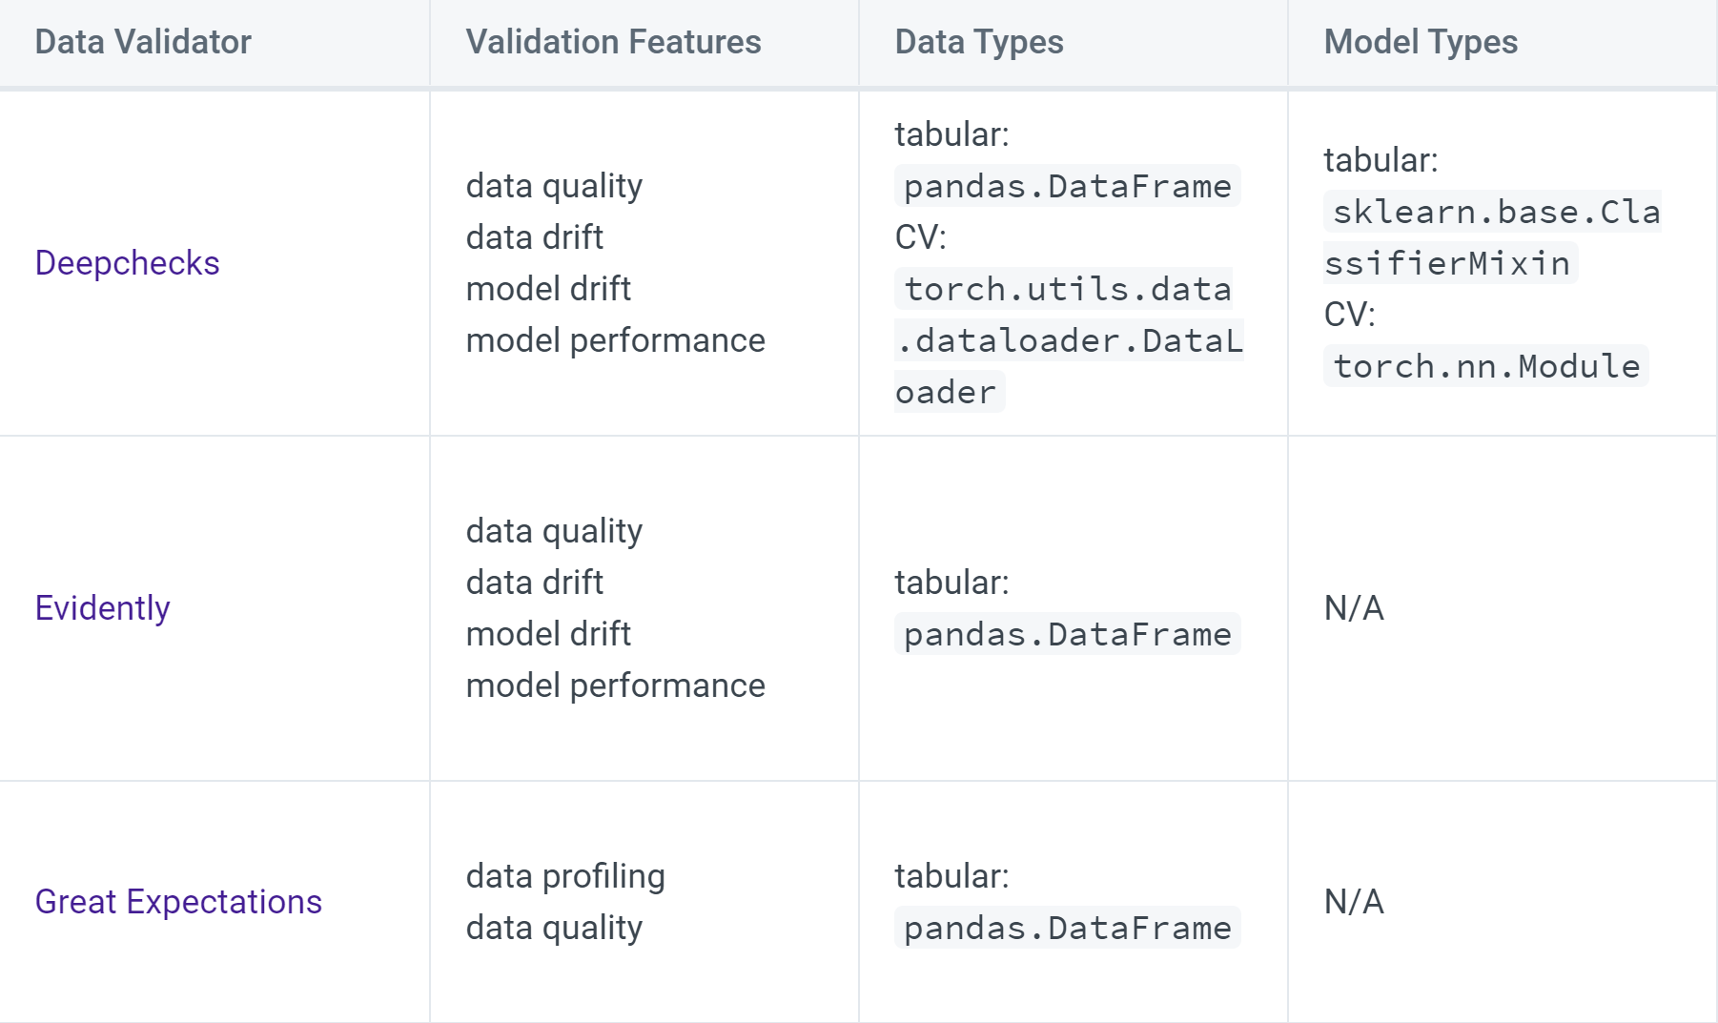
Source: Data Validators - ZenML Documentation
Notes:
The ZenML documentation has this table for data validators that allows you to compare the specs for different tools.
So all good, you check the specs and you finalize on a tool, you build a PoC and it works as you wanted. Boom, problem solved. But it’s not always this simple.

Slide 13

Problem: High cost of experimentation
Someone in your team needs to devote time to understand how to install and configure a new tool in your workflow.
Code development is paralyzed until a tool is fixed and this acts as a blocker for other teams.

Slide 14

Problem: FOMO on a new tool
If I invest in a tool now but a new one comes up which is better, what do I do?
History has shown that companies that fail to adapt to new technologies might not fare as well as others.

Slide 15

ZenML is an extensible open-source framework that allows separation between your code and your stack

Slide 16

Write your code in the form of portable pipelines

Slide 17
All the tools you need form part of a ZenML stack

Slide 18

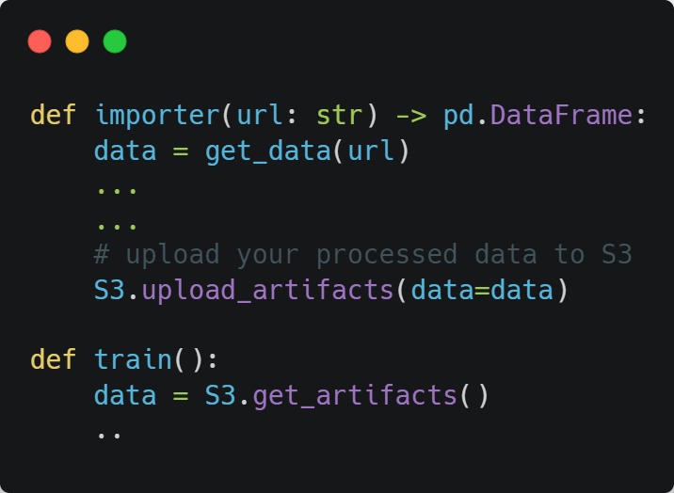
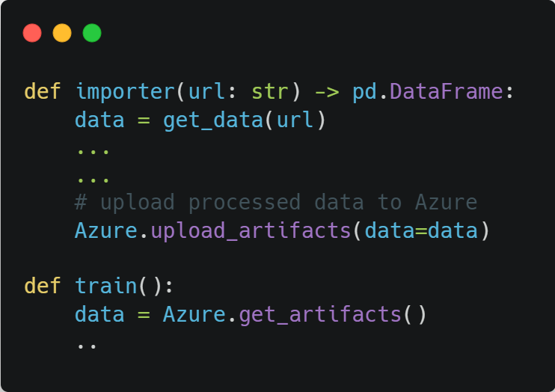

Switching artifact stores: Without ZenML
Pipeline Code

Slide 19

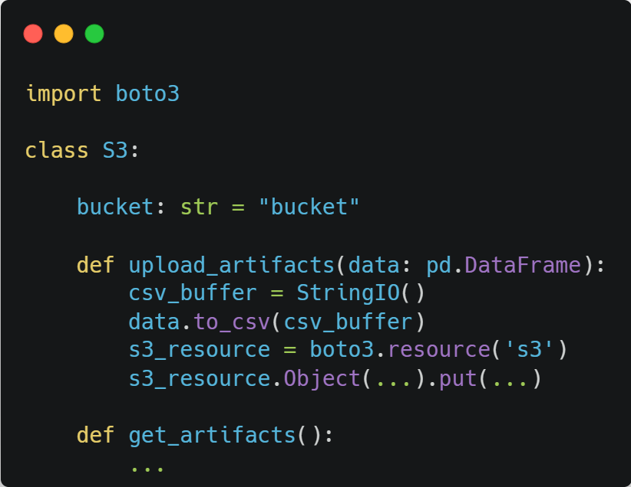
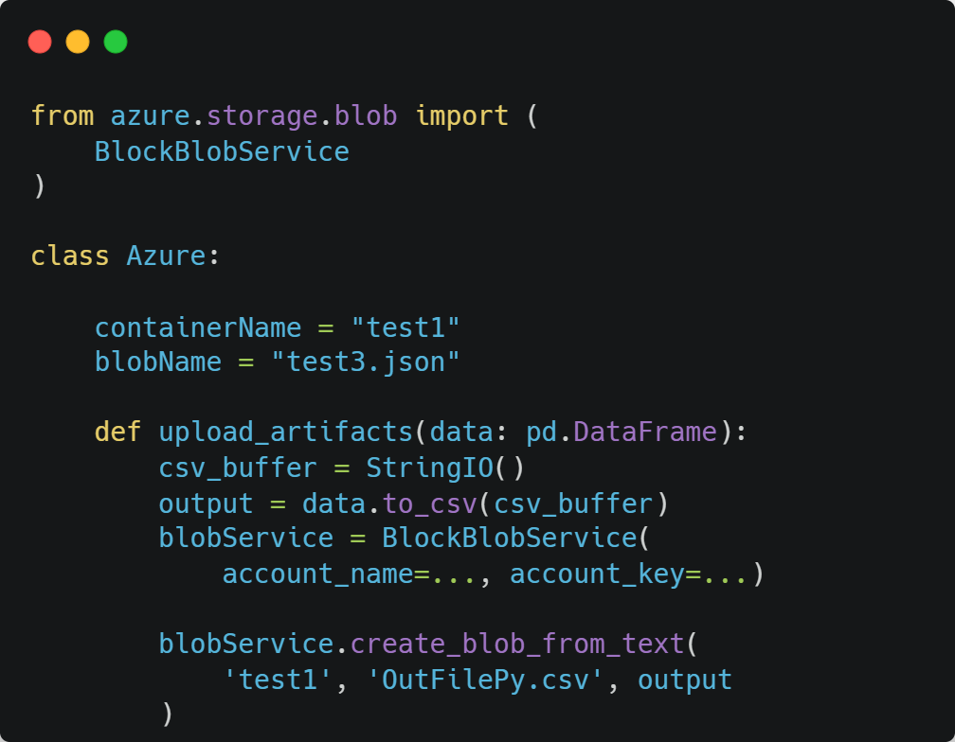
Switching artifact stores: Without ZenML
Tool Implementation

Slide 20
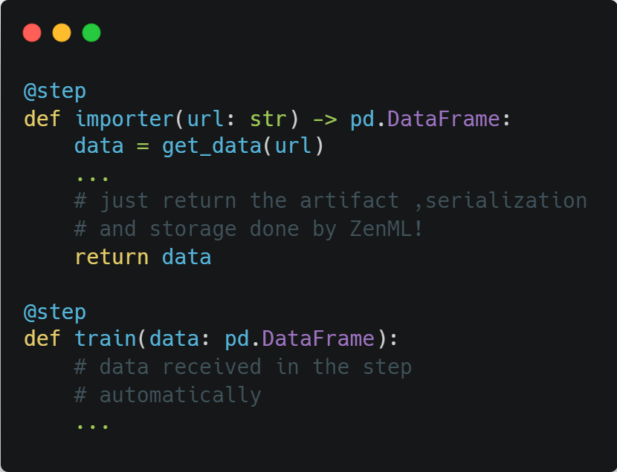

Switching artifact stores: With ZenML 🧘
Pipeline Code
No changes needed!

Slide 21
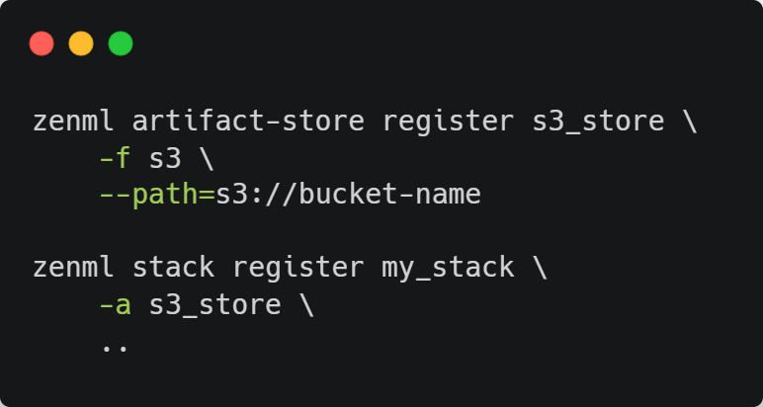
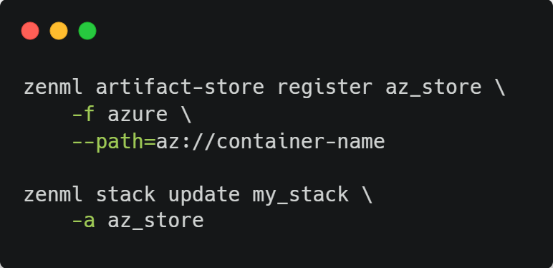
Switching artifact stores: With ZenML 🧘
Tool Implementation: Updating your stack is enough!

Slide 22
Demo: Let’s see ZenML in action! 🦸
How do you create ZenML pipelines?
How is a stack defined? Is there an easy way to spin up cloud resources for my MLOps stack?
Switching between MLflow and Weights and Biases experiment trackers.
Sharing stacks with your team and monitoring pipeline runs through the ZenML Dashboard.

Slide 23


Thank you!
Presentation title
Join the ZenML Slack
Check out the website!
Jayesh Sharma
Jr. Platform Engineer, ZenML

Slide 24



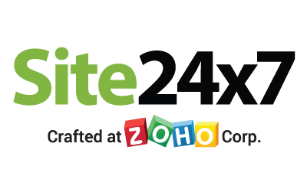


Platinum Partner
Gold Partner
Silver Partner

